Slide 1
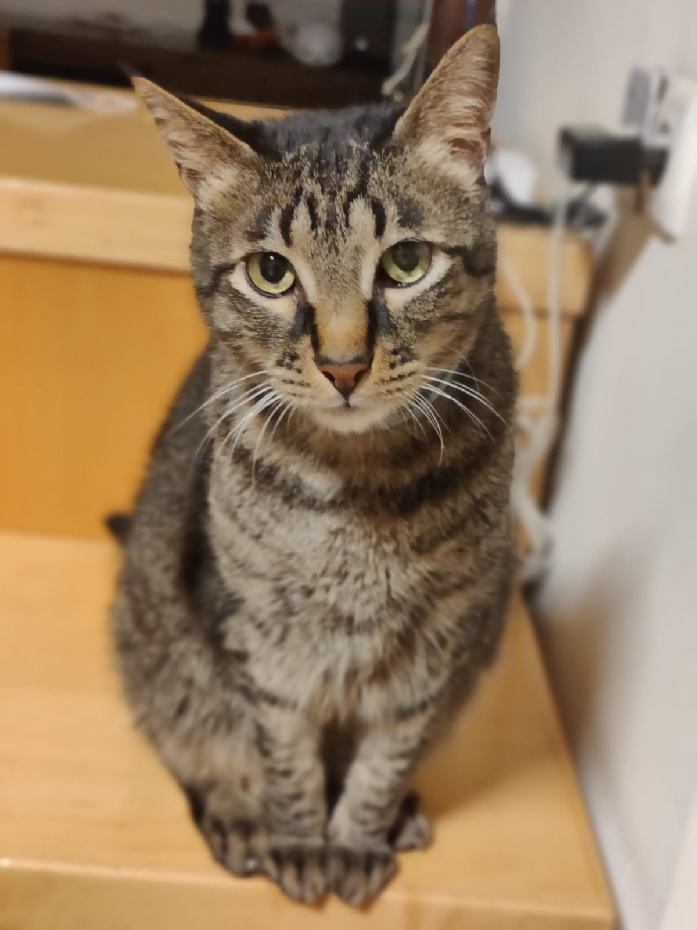

Slide 2
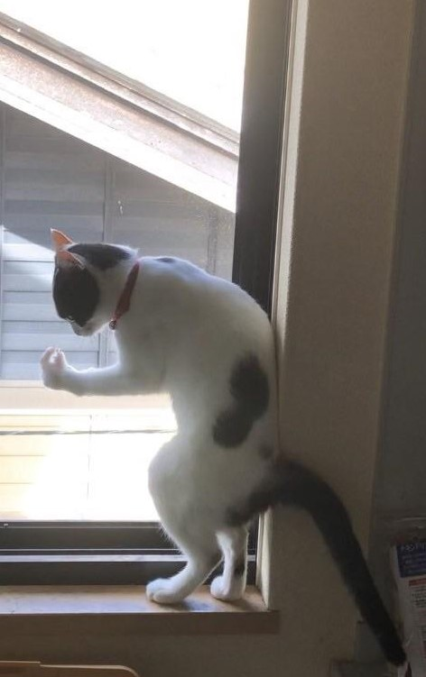
Windowino
Pwease opew up …
Window open by proximity of specific BLE device
Notifications via internet connection
Smart safety mechanism for dumb cats (and people)

Slide 3
Things we learned along the way
Handling Arduino and Esp
3D designing and printing
Sensors and motor components
wiring and electrical circuits
Programing and hardware debugging
Working with measurement devices
Working with tools

Slide 4
Some of the used components
Esp 32
BLE pet tracking device
Stop switches
Ultrasonic sonars
3D printer
Step motor and step motor driver
Power supply
Wires

Slide 5
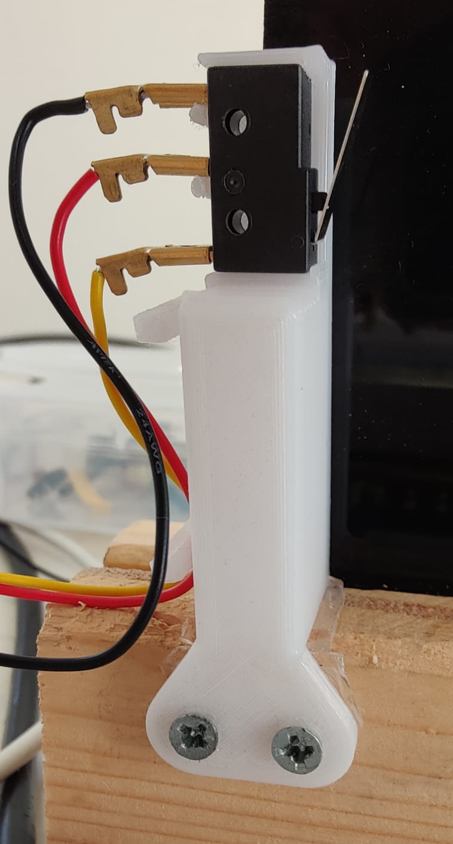
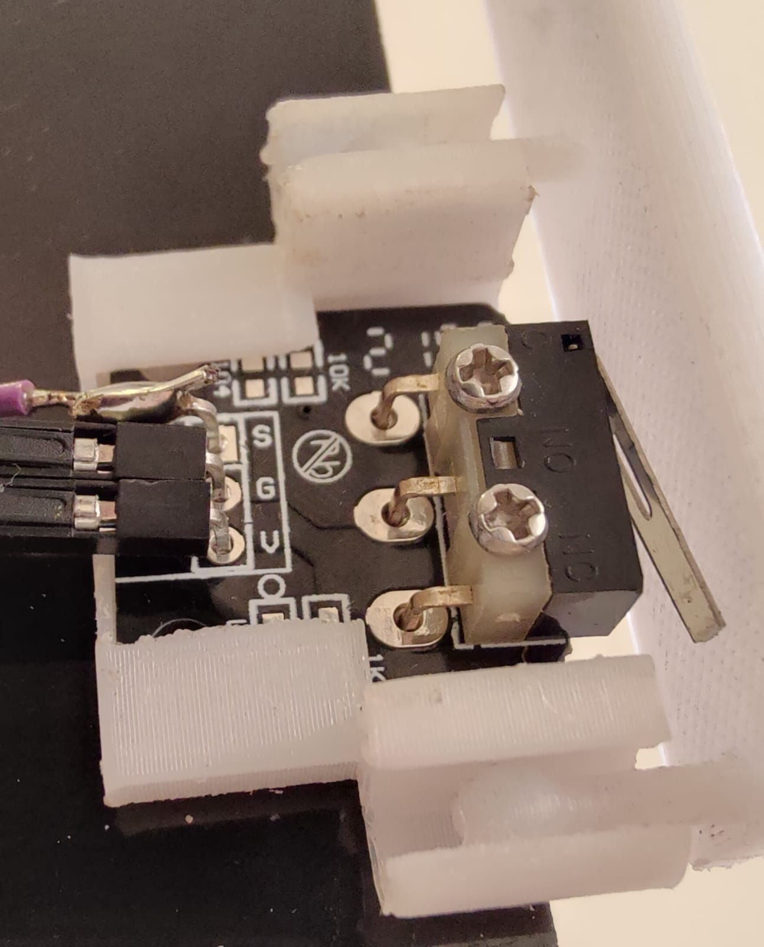
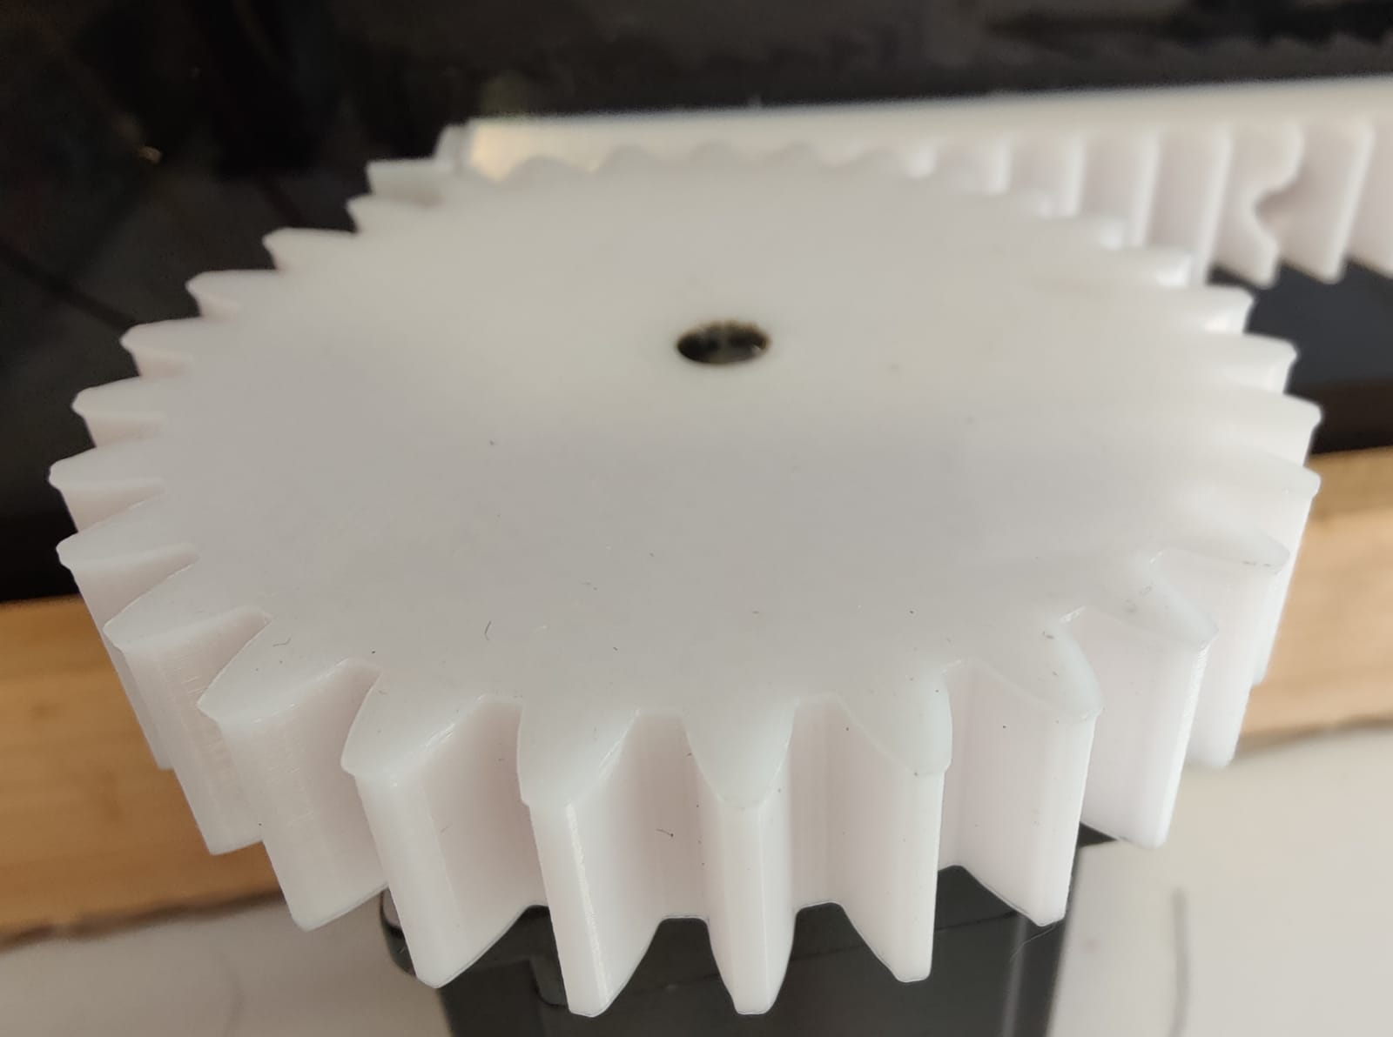
Some of the 3d printed parts
Back stop-switch turret
Front stop-switch bracket
Motor gear

Slide 6
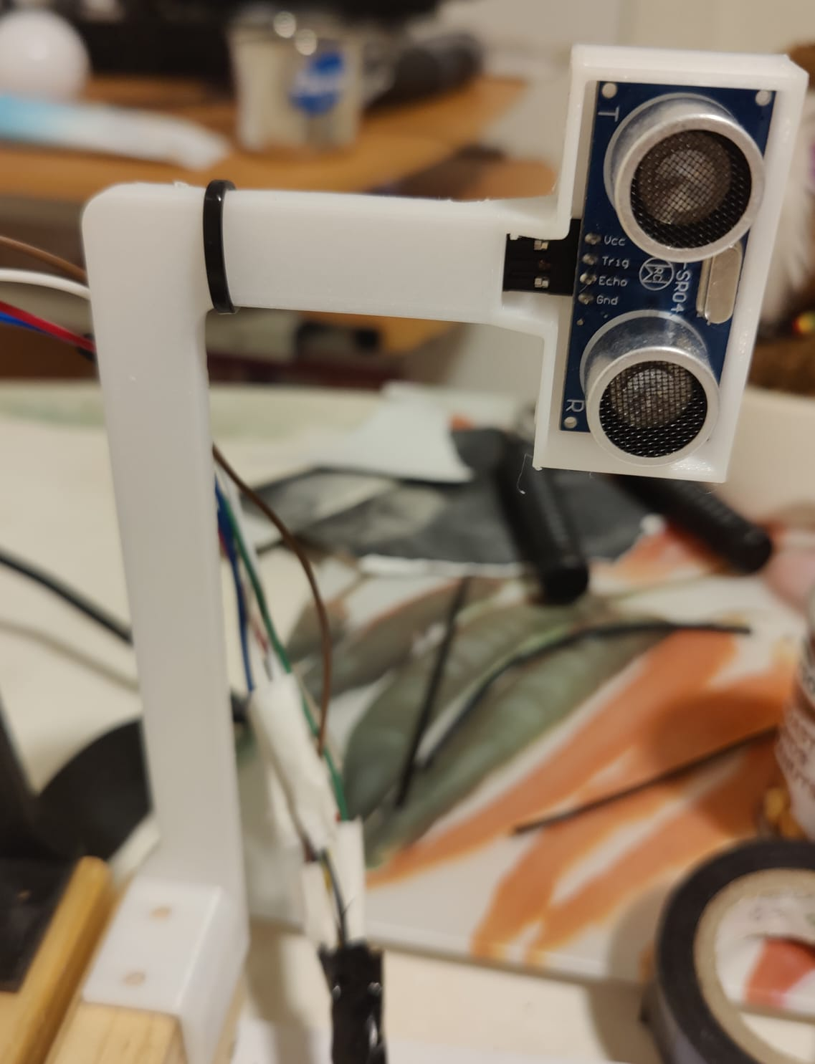
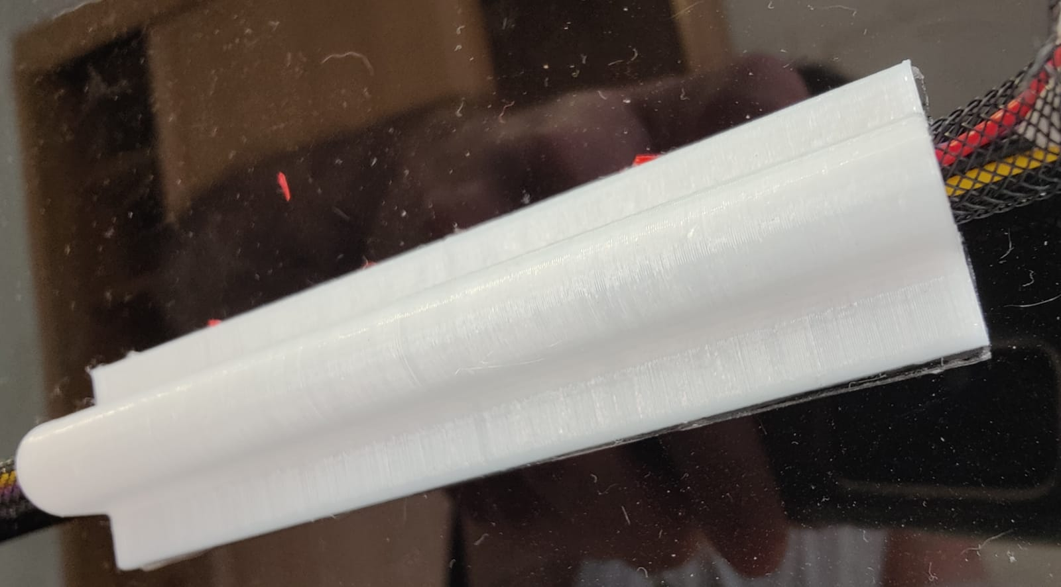
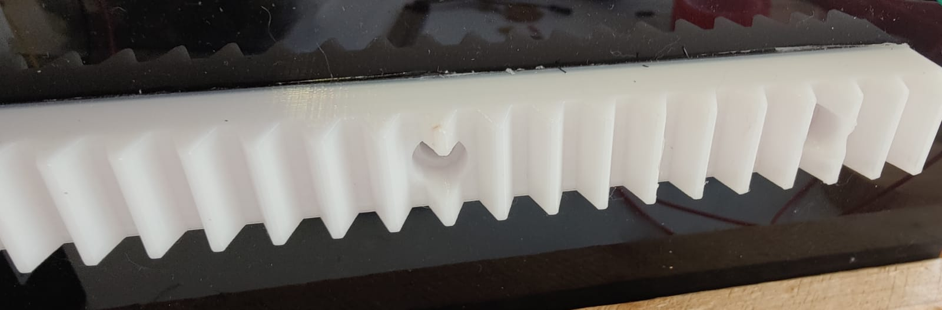
And some more…
Ultra sonic sonar turret
Wiring sleeve
Gear rack

Slide 7
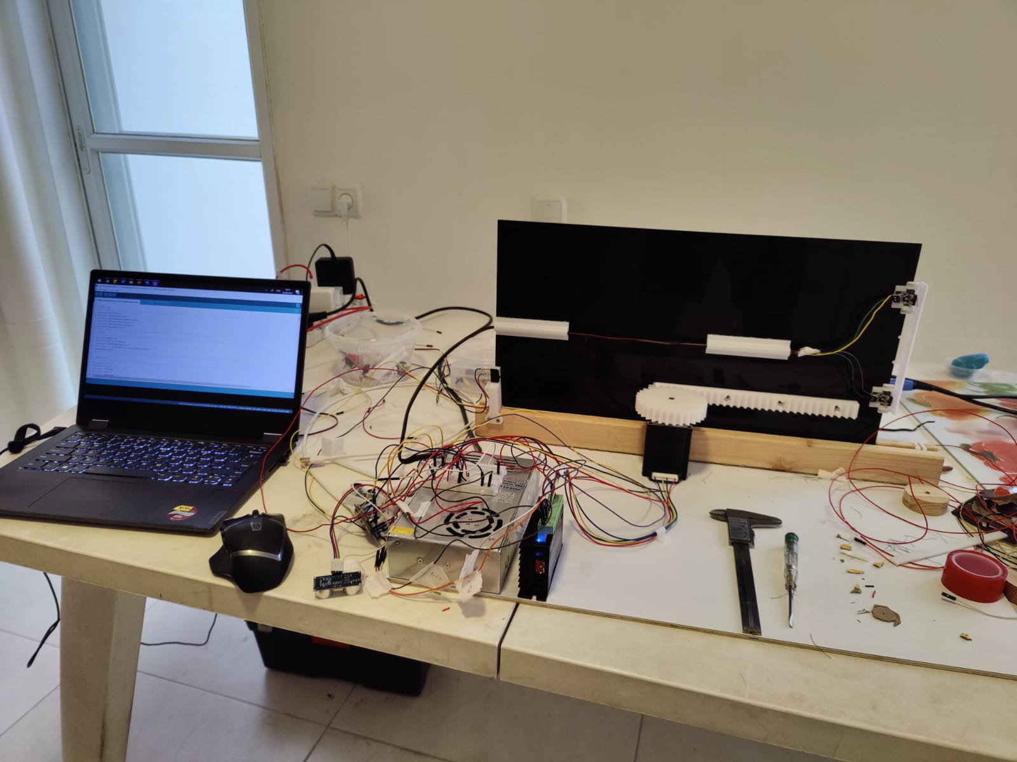
War room

Slide 8
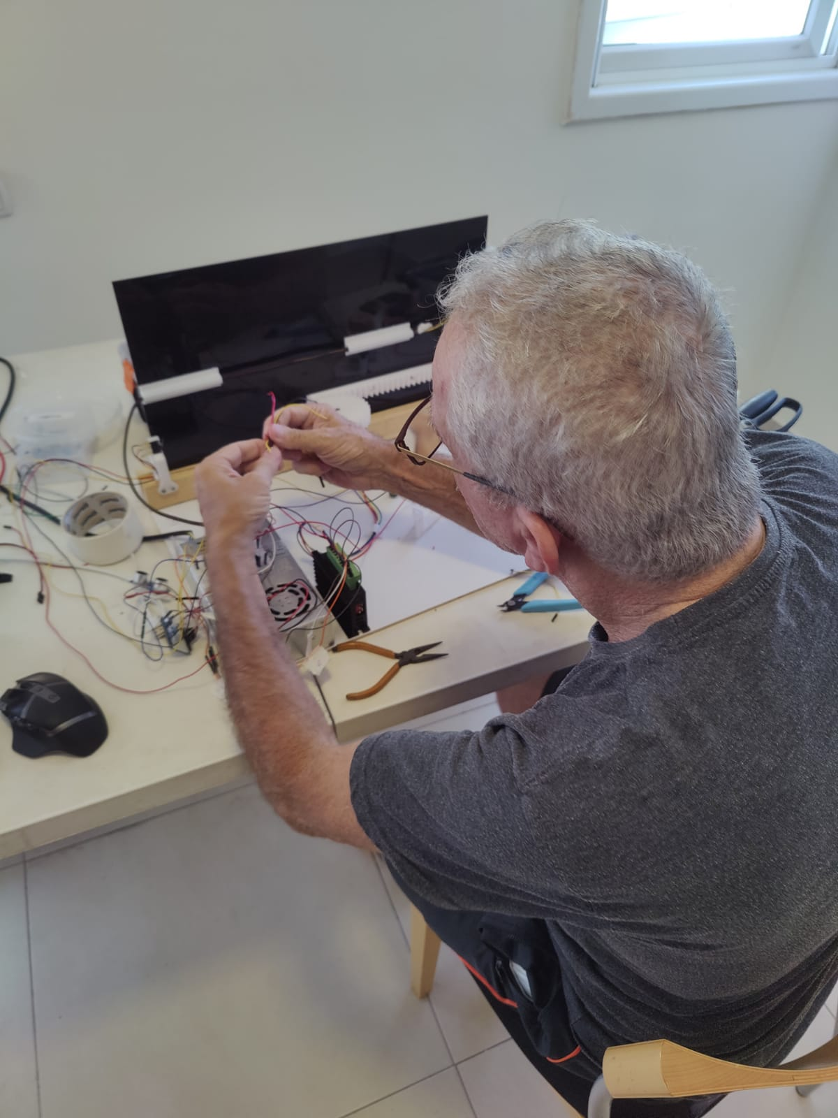
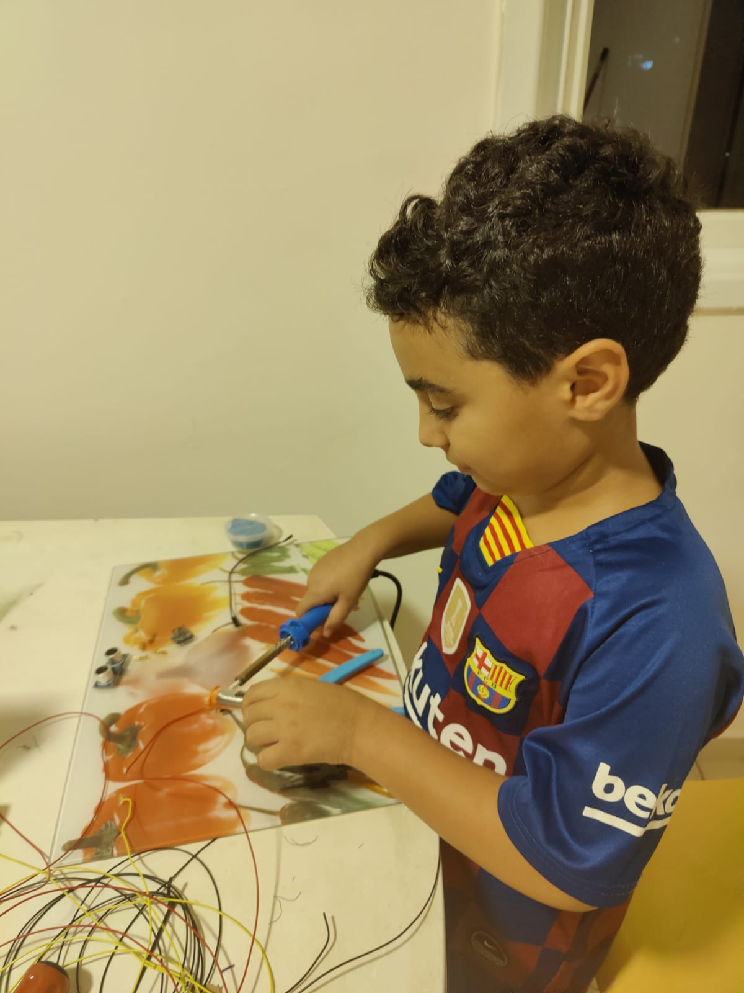
The team
Shaul, A.K.A father, all-round expertise
Roi, soldering master and snacks distributor

Slide 9
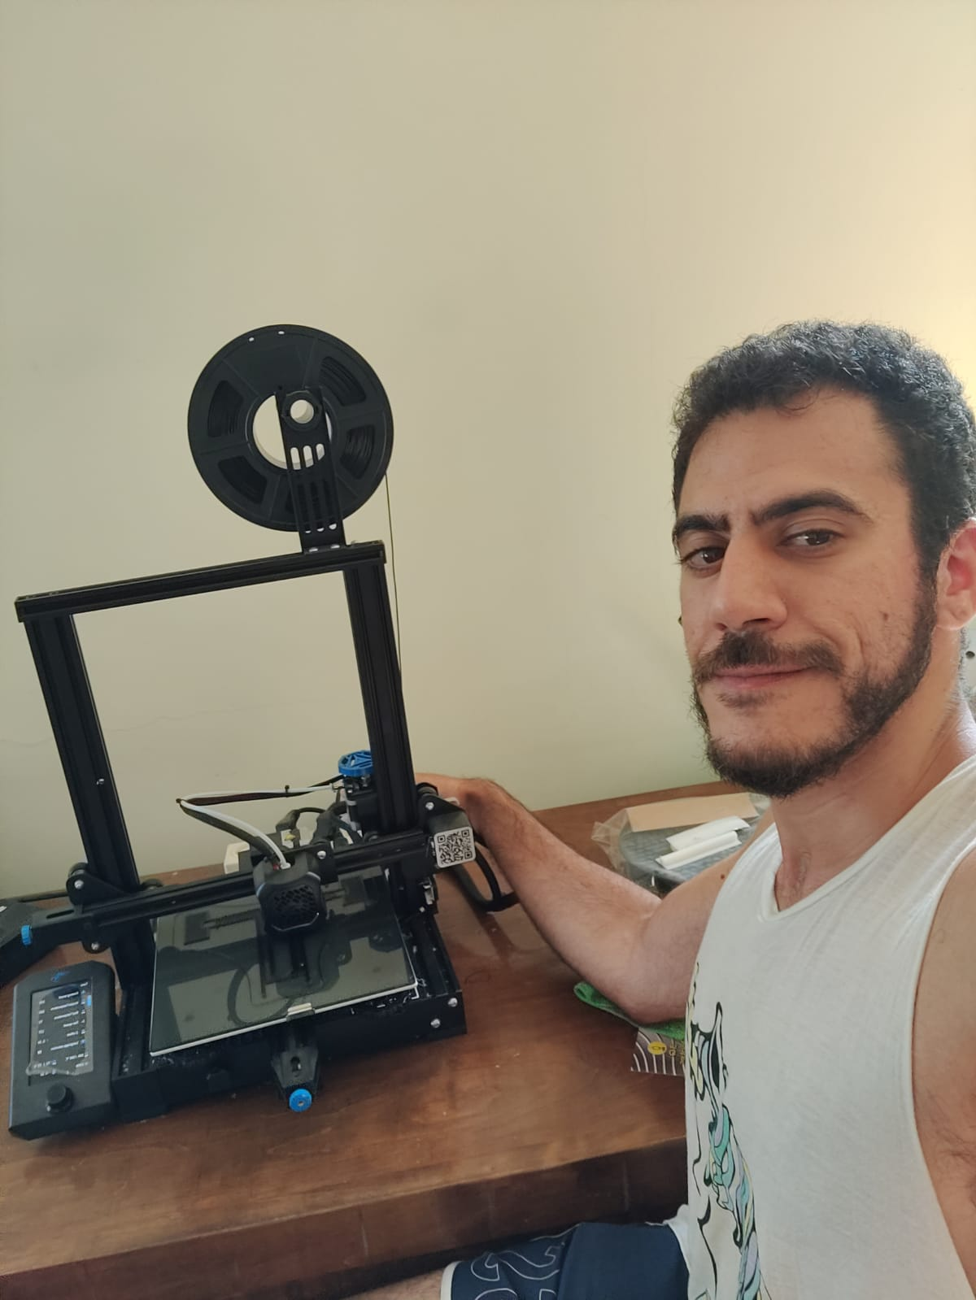
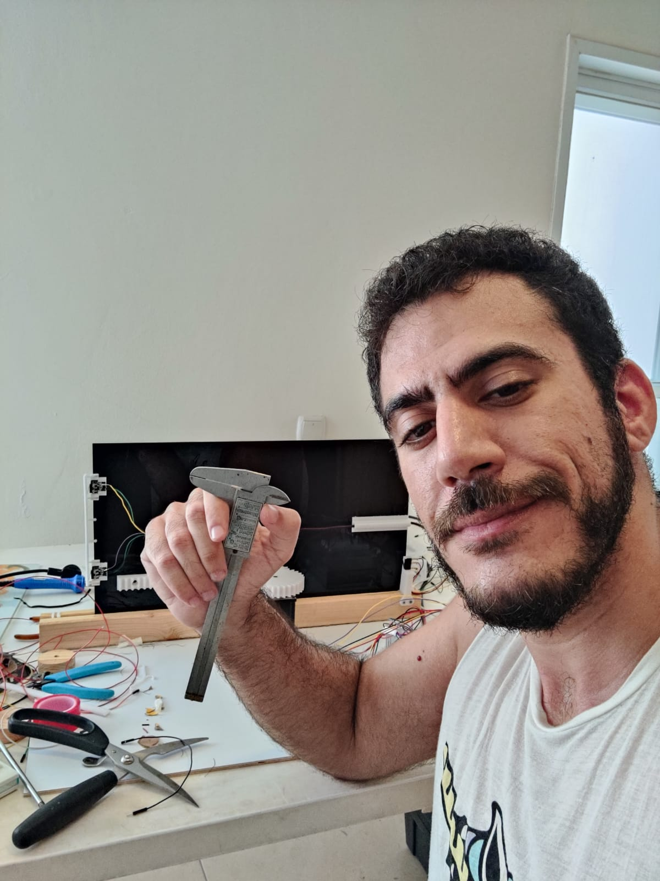
The 3D printer
The caliber

Slide 10
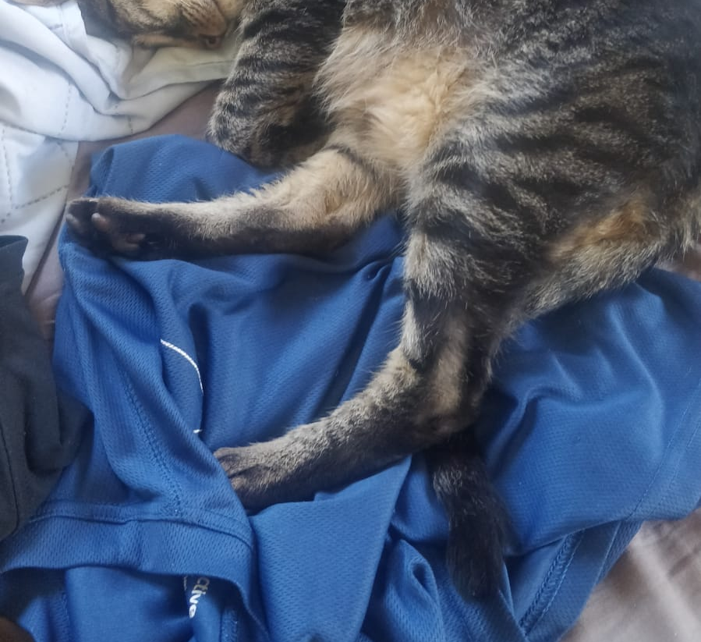
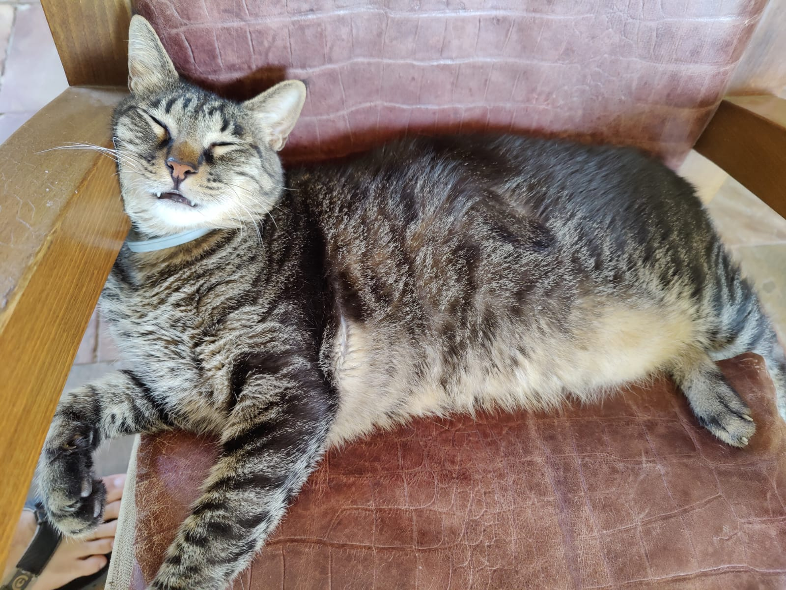
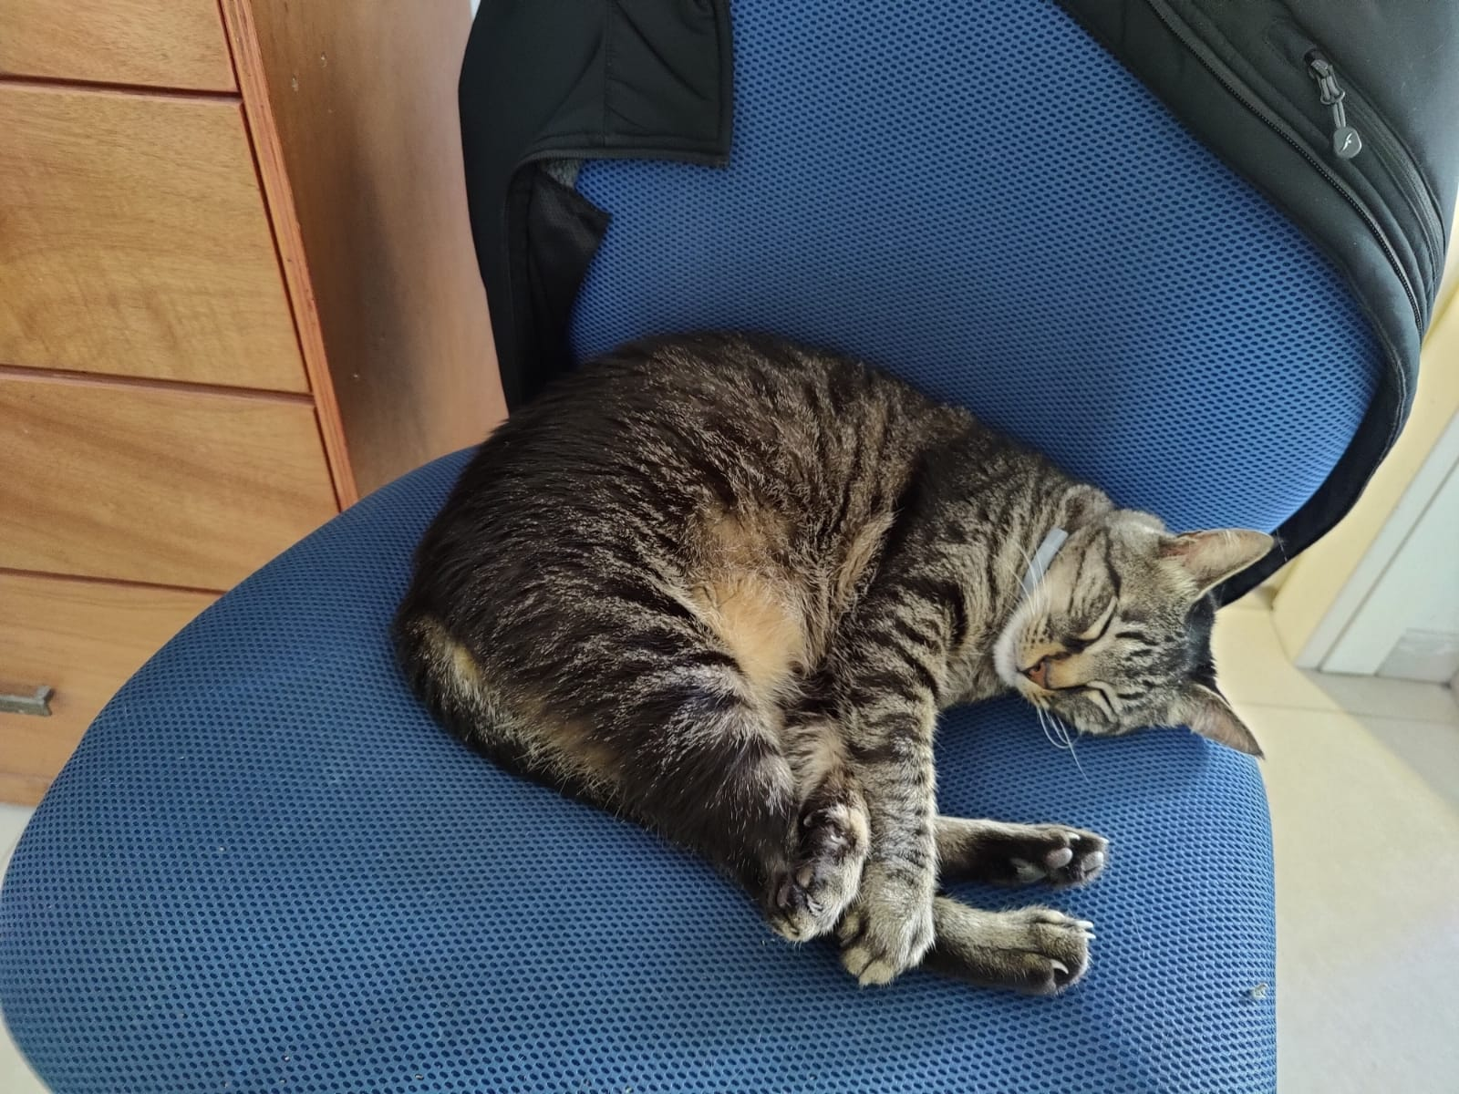
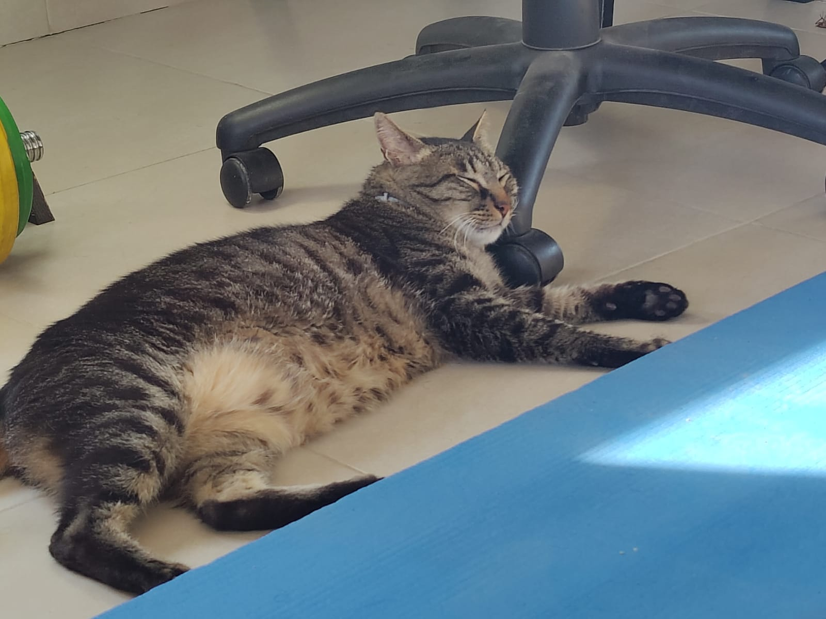
How we look at the end of the day

Slide 11
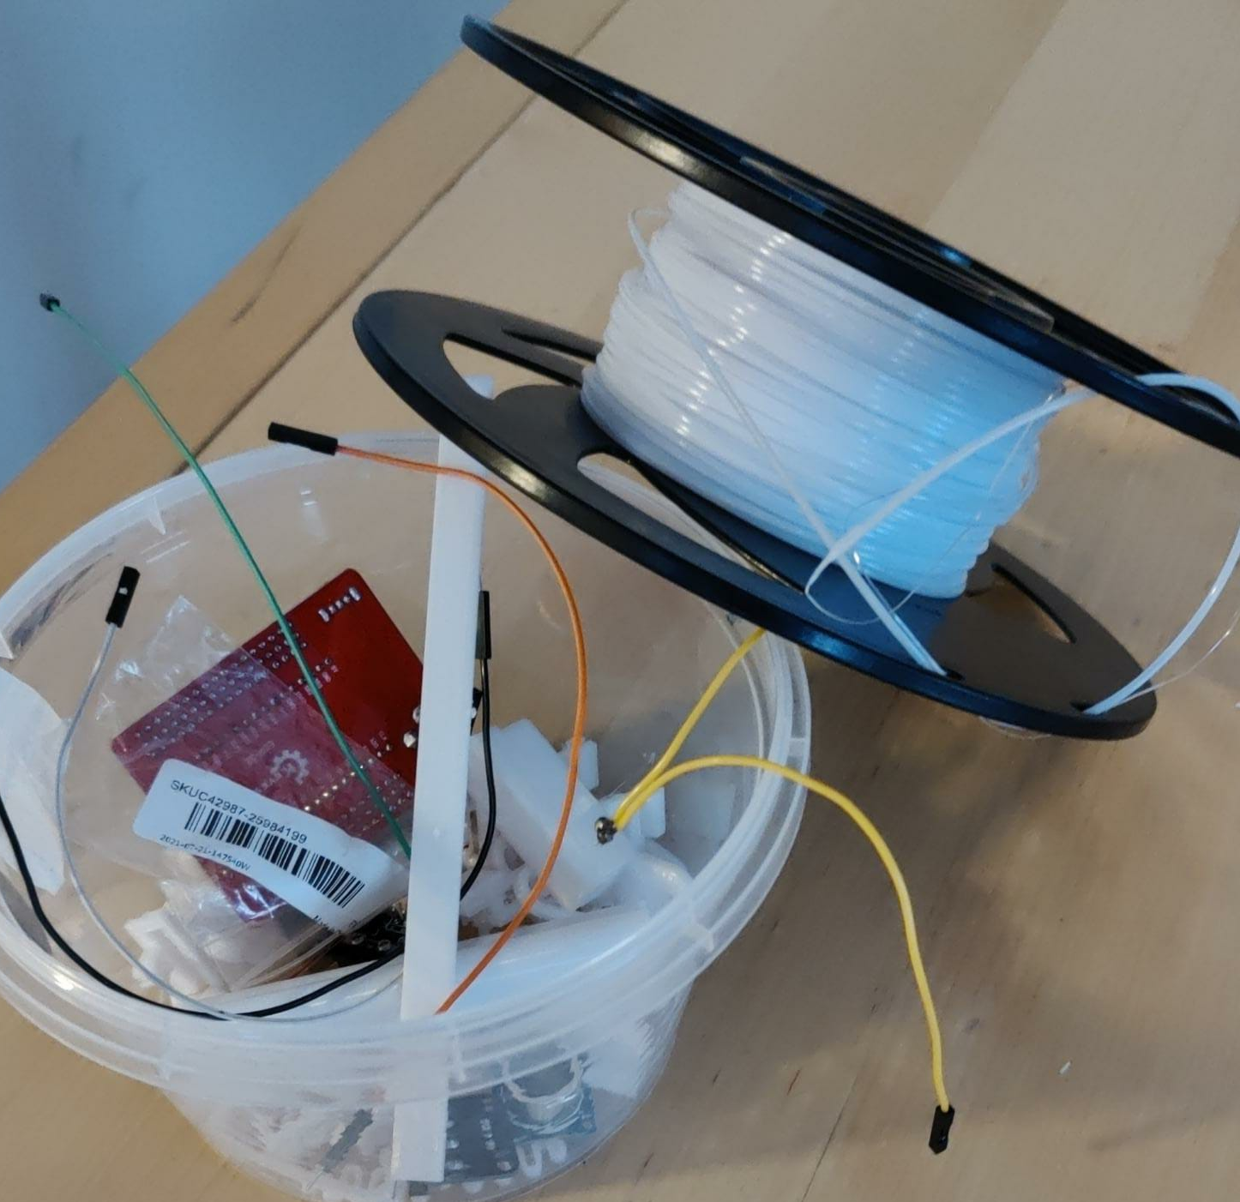
The men we lost

Slide 12
